Slide 1
Examples of Mathematical Programs
(JSS30 Exercises Day01a)

Slide 2






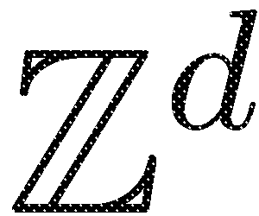




Classification: Mathematical Programming
*A QP is also an NLP; A ILP is also a IP.
$$x^{T} A x$$
For the comprehensive authorative classification of INFORMS by Dantzig, see: http://glossary.computing.society.informs.org/index.php?page=nature.html

Slide 3
Multiobjective Mathematical Program
multiobjective optimization

Slide 4

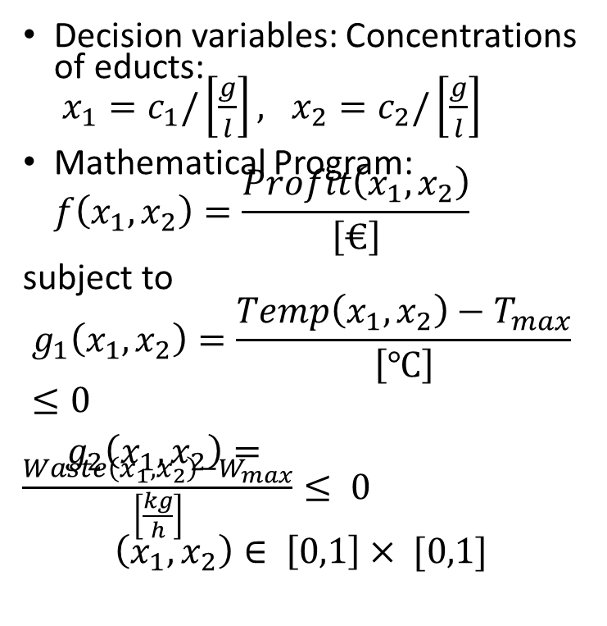
Example 1: Mathematical Program for Reactor
Chemical Reactor
Profit to be maximized, while temperature and waste must not exceed certain thresholds.
How to formulate this as a mathematical program?
Decision variables: Concentrations of educts: $x_{1}=c_{1}/\left[\frac{g}{l}\right], x_{2}=c_{2}/\left[\frac{g}{l}\right]$
Mathematical Program: $f\left(x_{1}, x_{2}\right)=\frac{Profit\left(x_{1},x_{2}\right)}{\left[€\right]}→Max$
subject to
$$g_{1}\left(x_{1},x_{2}\right)=\frac{Temp\left(x_{1},x_{2}\right)−T_{max}}{\left[℃\right]}≤0$$
$g_{2}\left(x_{1},x_{2}\right)=\frac{Waste\left(x_{1},x_{2}\right)−W_{max}}{\left[\frac{kg}{h}\right]}≤ 0$
$$\left(x_{1},x_{2}\right)∈ \left[0,1\right]× [0,1]$$
Profit(x1,x2)
Chemical
Reactor Model
x1
Waste(x1,x2)
Temperature(x1,x2)
x2

Slide 5
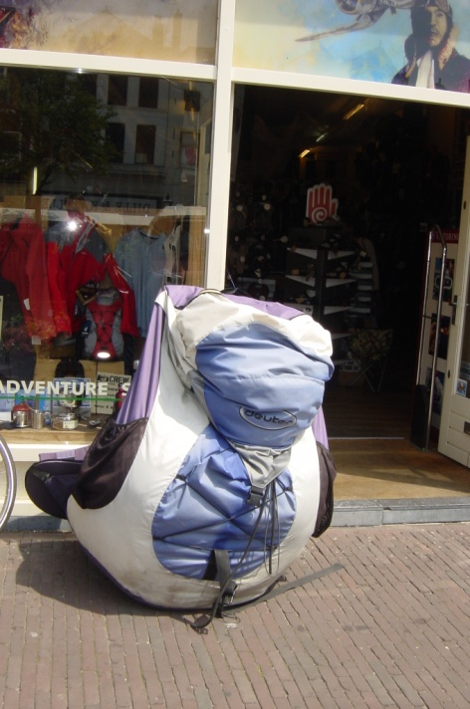
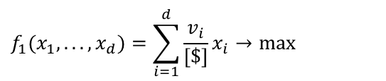

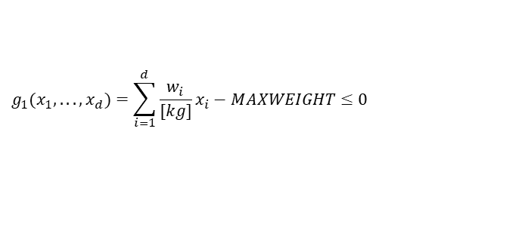
Example 2: Constrained 0/1 Knapsack Problem
The total value of the items in the knapsack (in [$]) should be maximized, while its total weight (in [kg]) should not exceed MAXWEIGHT. Here v_{i} is the value of item i in [$] and w_{i} is its weight in [kg]. i=1, …, d are indices of the items.
$$f_{1}(x_{1},...,x_{d})=\sum_{i=1}^{d}{\frac{v_{i}}{[\$]}}x_{i}→max$$
$$g_{1}(x_{1},...,x_{d})=\sum_{i=1}^{d}{\frac{w_{i}}{[kg]}x_{i}}−MAXWEIGHT≤0$$
$$x_{i}∈\{0,1\},i=1,...,n$$
Picture: © Michael Emmerich (instructor)
What is the role of the binary variables here?
What type of mathematical programming problem is this?
Can this also be formulated as a quadratic programming problem?

Slide 6
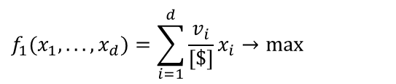

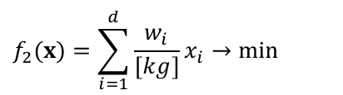
Example: Multiobjective 0/1 Knapsack Problem
The total value of the items in the knapsack (in [$]) should be maximized, while its total weight (in [kg]) should be minimized.
$$f_{1}(x_{1},...,x_{d})=\sum_{i=1}^{d}{\frac{v_{i}}{[\$]}}x_{i}→max$$
$$f_{2}(x)=\sum_{i=1}^{d}{\frac{w_{i}}{[kg]}x_{i}}→min$$
$$x_{i}∈\{0,1\},i=1,...,n$$

Slide 7
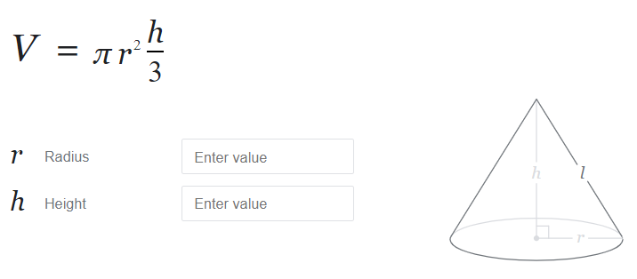


Example: Equality Constraint for Tin Problem
Minimize the area of surface A for a cylinder that contains V = 330 ml sparkling juice! $x_{1} = radius/[cm^{2}], x_{2}=height/[cm^{2}]$
x₁
$$f(x)=2πx_{1}x_{2}+2π(x_{1})^{2}→min \\ h(x)=2πx_{2} (x_{1})^{2}=330 \\ x∈\left[\left(\begin{matrix}0 \\ 0\end{matrix}\right),\left(\begin{matrix}∞ \\ ∞\end{matrix}\right)\right]⊂ℝ$$
330ml
x₂
Inside cone
Problem sketch
Exercise: Formulate the problem for icecream cones as a mathematical programming problem! Surface of waffle to be 100ml Volume maximized (1/2 sphere+cone volume)
Some interesting research question: Find optimal shapes or given constraints on geometry.
For instance: Convex hull of N points with minimal surface and maximal volume.

Slide 8
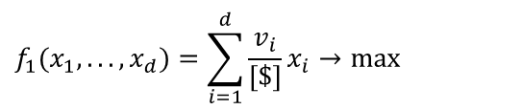
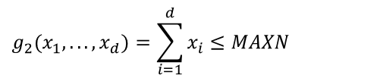

Example: Knapsack Problem with Cardinality Constraint
The total value of the items in the knapsack (in [$]) should be maximized, while its total weight (in [kg]) should be below MAXN and at most MAXN items can be chosen.
$$f_{1}(x_{1},...,x_{d})=\sum_{i=1}^{d}{\frac{v_{i}}{[\$]}}x_{i}→max$$
$$g_{1}(x_{1},...,x_{d})=\sum_{i=1}^{d}{\frac{w_{i}}{[kg]}x_{i}}−MAXWEIGHT≤0$$
$$g_{2}(x_{1},...,x_{d})=\sum_{i=1}^{d}{x_{i}}≤MAXN$$
$$x_{i}∈\{0,1\},i=1,...,d$$

Slide 9










Example: Traveling Salesperson Problem
$v_{o}$
$v_{1}$
$v_{8}$
$v_{7}$
$v_{5}$
$v_{6}$
$v_{4}$
$v_{2}$
$v_{3}$
This can be easily described, but how to model this in terms of discrete (binary) variables and (constraint) functions that depend on them?

Slide 10
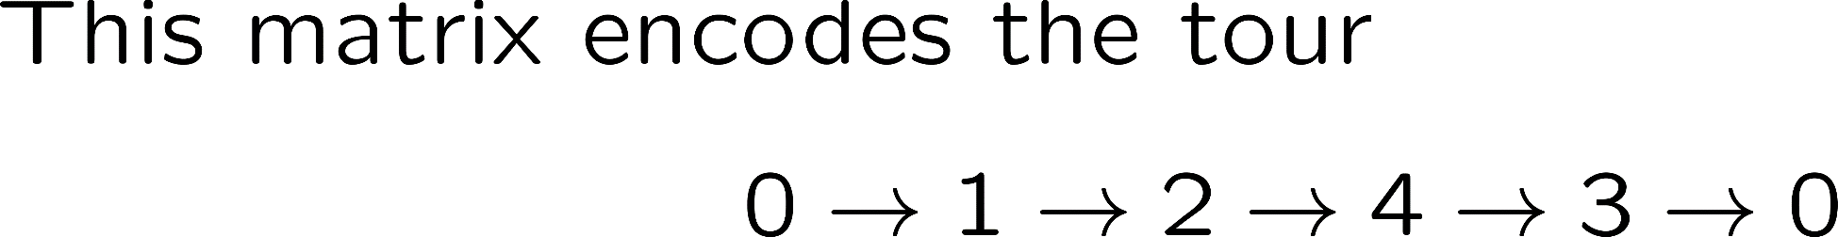
Encoding of a TSP tour
City 1 | City 2 | City 3 | City 4
1 | 0 | 0 | 0
0 | 1 | 0 | 0
0 | 0 | 0 | 1
0 | 0 | 1 | 0

Slide 11
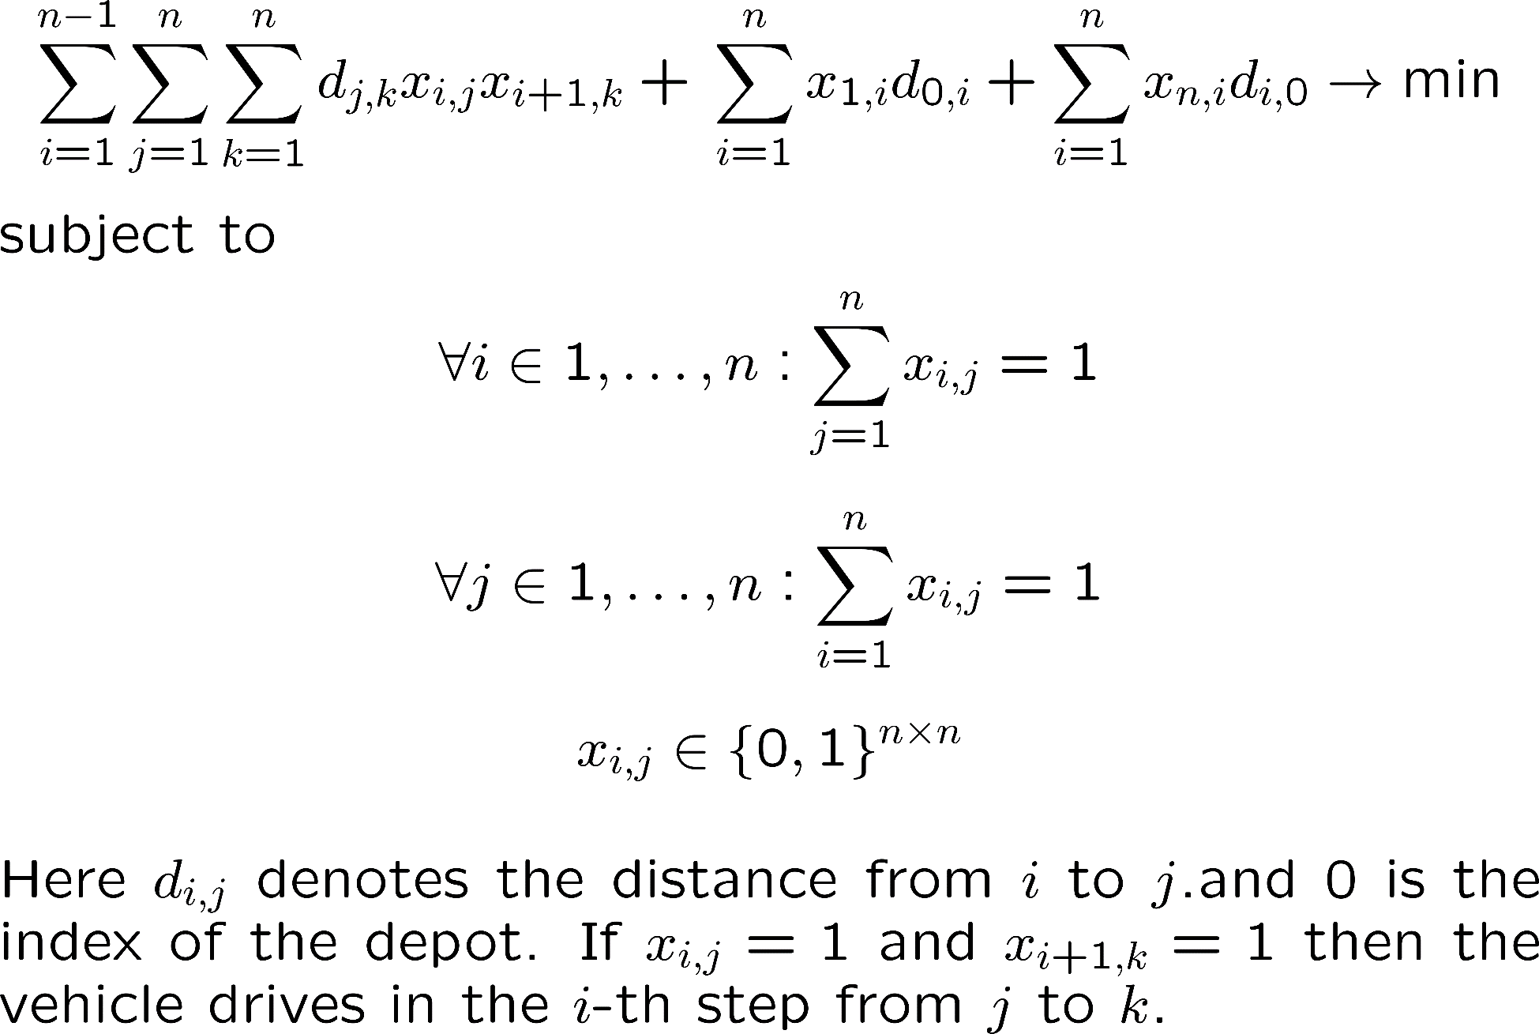
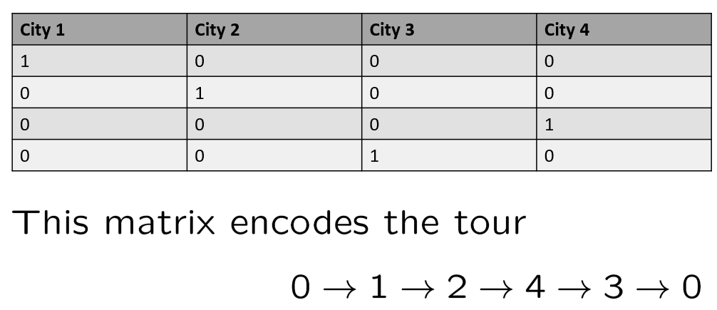


Recall. Previous slide
Exercise: How does this equation change if one is starting at node $0$ and the tour needs to end in other depot, say node $n$?

Slide 12


Mathematical Programming Models: Exercise
Question: How to solve problems of the following kind with an LP solver:
$max⁡\{u_{1}(x_{1}, …, x_{n}), … ,u_{m}(x_{1}, …, x_{n})$} $→ min$
where $u_{1} … u_{m}$ are linear functions of the type
$u_i(…) = a_{i1} x_{1} + … a_{im} x_{i}$?
Answer: ….
MIN
MAX
Trick
QP
Trick
Let us assume the problem $a_{1} x_{1} … a_{m} x_{m} → min⁡$
s.t. $w_{1} x_{1} + … w_{n} x_{n}≤ c$, $x_{i}∈\{0,1\}$, i$=1 … n$
How can we formulate it as a nonlinear problem with continuous variables?
Answer: ….

Slide 13


Mathematical Programming Models
Question: How to solve problems of the following kind with an LP solver:
$max⁡\{u_{1}(x_{1}, …, x_{n}), … ,u_{m}(x_{1}, …, x_{n})$} $→ min$
where $u_{1} … u_{m}$ are linear functions of the type
$u_i(…) = a_{i1} x_{1} + … a_{im} x_{i}$?
Answer: ….
MIN
MAX
Trick
QP
Trick
$$f\left(x_{1},…, x_{n},x_{n+1}\right)=x_{n+1}→min$$
$$s.t. a_{i1}x_{1}+…a_{im}x_{i}≤x_{n+1} , i=1,…,m$$
Let us assume the problem $a_{1} x_{1} … a_{m} x_{m} → min⁡$
s.t. $w_{1} x_{1} + … w_{n} x_{n}≤ c$, $x_{i}∈\{0,1\}$, i$=1 … n$
How can we formulate it as a continuous problem?
Answer: ….
$$\left(1−x_{i}\right)x_{i}=0, i=1,…,n \\ x_{i}∈IR$$

Slide 14
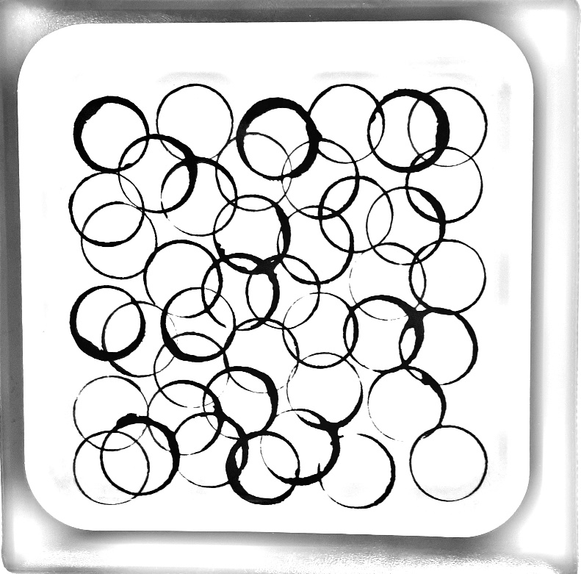
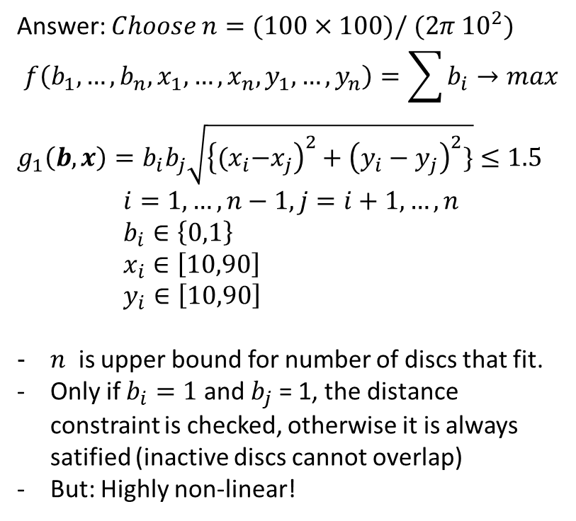
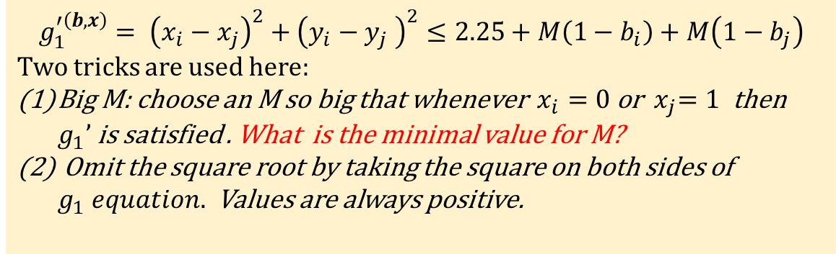
Placement of unit discs on the square – mixed integer problem – ‘Big M trick’
How to formulate the problem of placing as many unit discs of radius 1.5m possible on a square of side length 100meter? The unit discs may not overlap.
Answer: $Choose n=(100×100)/ (2π {10}^{2})$
$$f\left({b_{1},…, b_{n},x}_{1},…, x_{n},y_{1},…,y_{n}\right)=\sum{b_{i}}→max$$ ${g_{1}\left(b,x\right)=b}_{i}b_{j}\sqrt{{\left\{{(x}_{i}−x_{j}\right)}^{2}+{\left(y_{i}−y_{j}\right)}^{2}\}}≤1.5$ $$i=1,…,n−1,j=i+1,…, n \\ b_{i}∈\left\{0,1\right\} \\ x_{i}∈\left[10,90\right] \\ y_{i}∈\left[10,90\right]$$
$n$ is upper bound for number of discs that fit.
Only if $b_{i}=1$ and $b_{j}$ = 1, the distance constraint is checked, otherwise it is always satified (inactive discs cannot overlap)
But: Highly non-linear!
Unit disc problem: Infeasible design due to overlap.
Alternative QP formulation (big M trick):
$$g_{1}^{′\left(b,x\right)}= {\left(x_{i}−x_{j}\right)}^{2}+{\left(y_{i}−y_{j} \right)}^{2}≤2.25+M\left(1−b_{i}\right)+M\left(1−b_{j}\right)$$ Two tricks are used here:
Big M: choose an M so big that whenever $x_{i}=0$ or ${ x}_{j}=1$ then $g_{1}’$ is satisfied . What is the minimal value for M?
Omit the square root by taking the square on both sides of $g_{1} equation.$ Values are always positive.

Slide 15
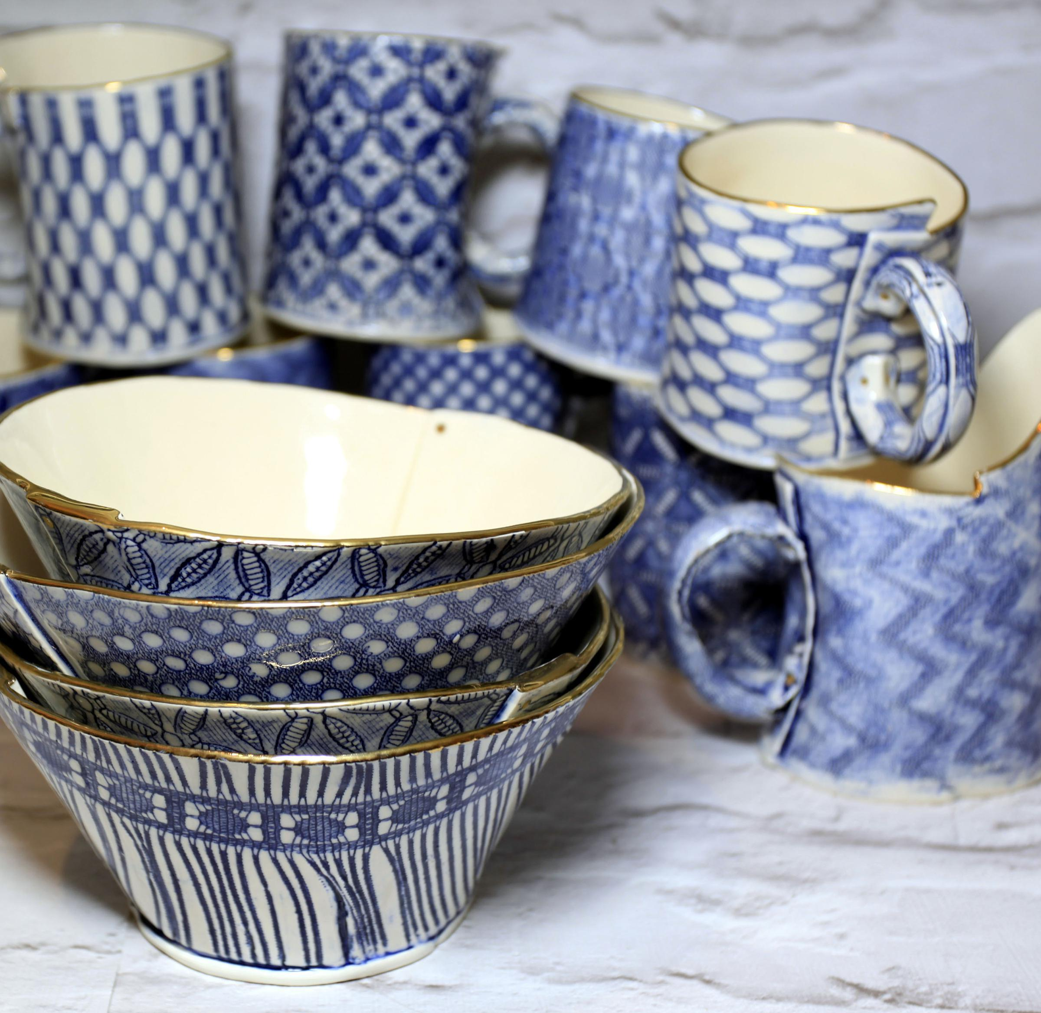

Exercise: Linear Programming
Making Mugs and Bowls
Mr. Asep makes mugs and bowls. It takes 4 minutes to make a mug and 3 minutes to make a bowl. A mug consists of 1kg of clay and a bowl requires 1.5kg. of clay. He has 20 hours available for making the mugs and bowls and has 450 kg. of clay on hand. He makes a profit of $2 on each mug and $3 on each bowl.
How many mugs and how many bowls should he make in order to maximize her profit? Solve graphically and/or with LP Solve.
x = number of produced mugs
y = number of produced bowls
This homework is only for exercise and not graded. The solution
will be discussed in the next lecture.
https://online-optimizer.appspot.com/?model=builtin:default.mod
http://www.pyomo.org/

Slide 16

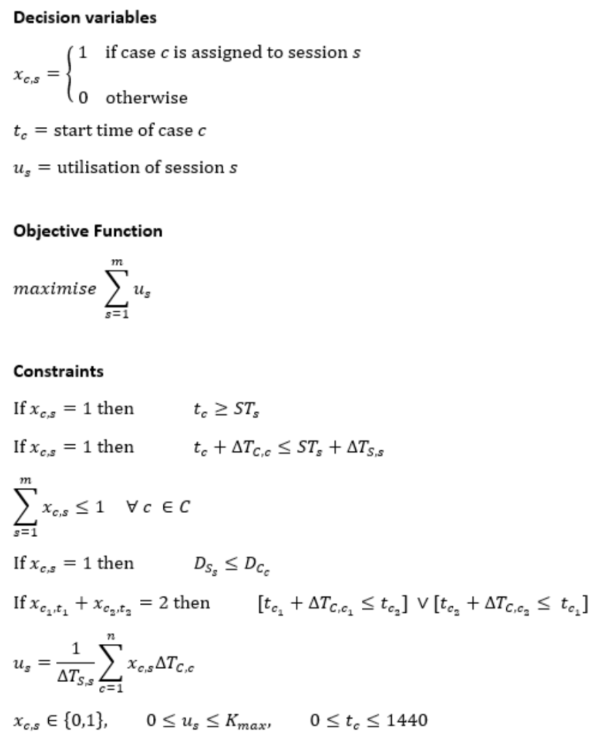
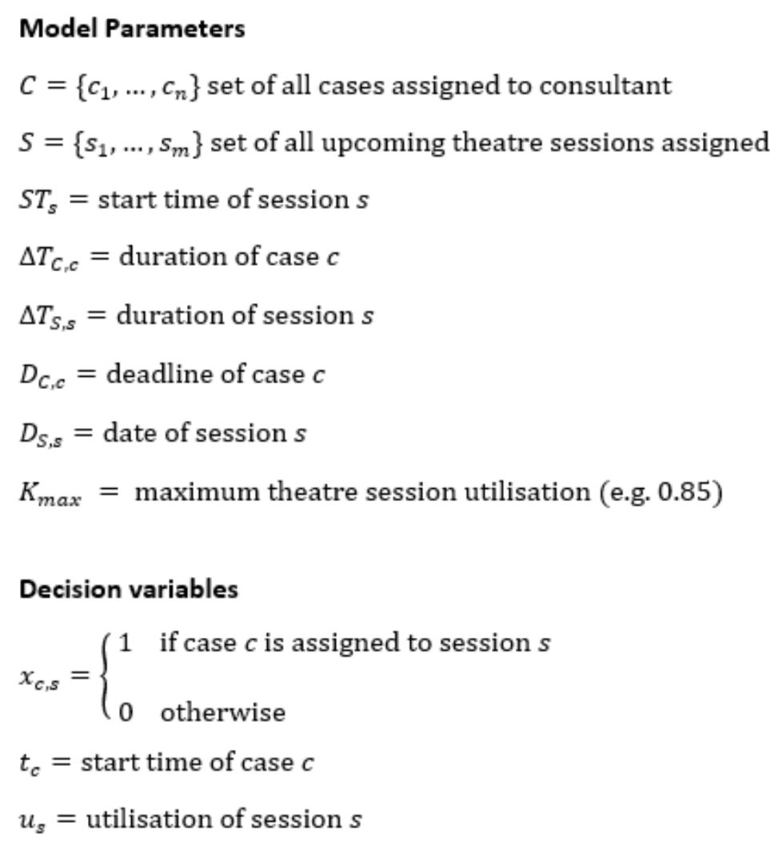

Timetabling example (pyomo)
https://towardsdatascience.com/schedule-optimisation-using-linear-programming-in-python-9b3e1bc241e1

